Slide 1
We help your organization become data driven

Slide 2
Drug adverse event monitoring with Tableau

Slide 3
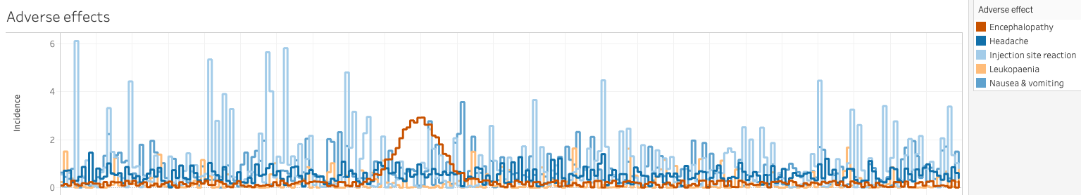
Drug adverse event monitoring with Tableau
Typically, patients taking a medication may exhibit a range of side effects.
These typically exhibit three patterns over time:
Uniform: occur regardless of treatment duration with a relatively constant frequency
Accumulative: occur with increasing risk as the duration of treatment progresses
Spike events: in an insolated group of patients, these events occur after a certain amount of time.
Identifying spike events (in this case, encephalopathy) can assist in tailoring maximum treatment duration and avoiding ADRs.

Slide 4
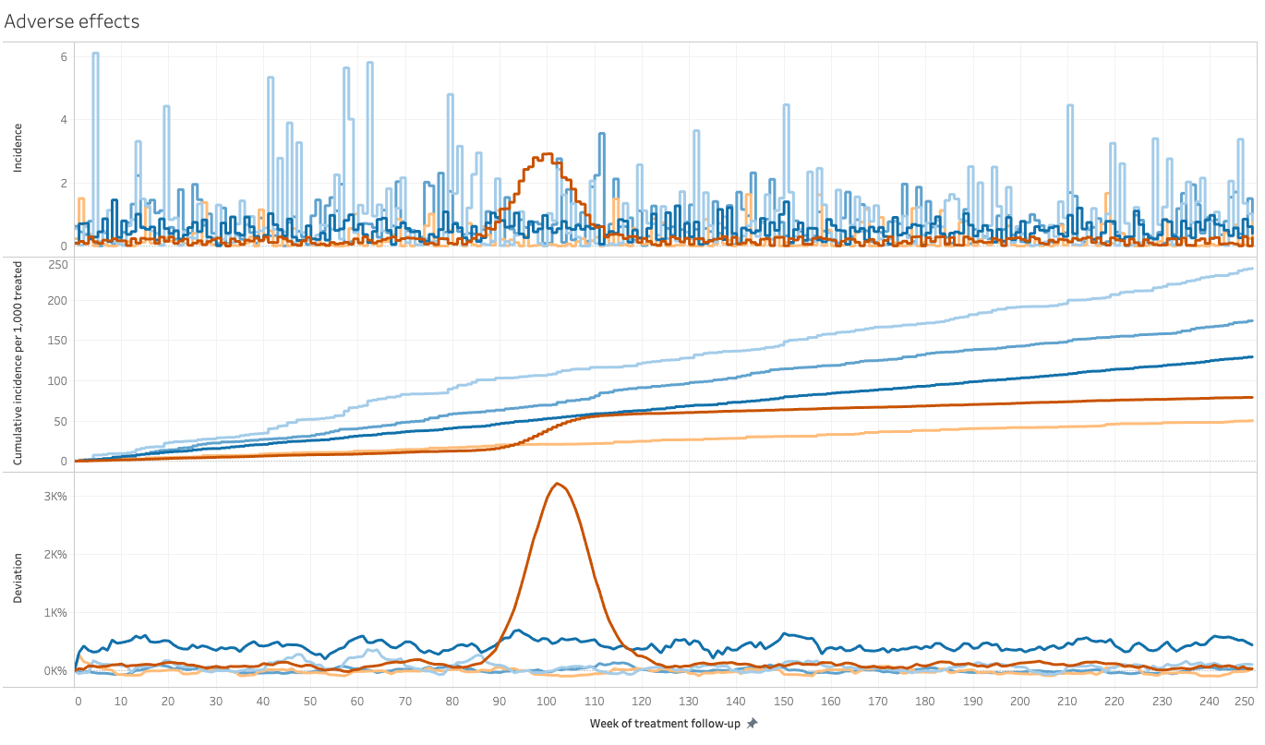
Indication of anomalous behaviour

Slide 5
COVID-19: a tale of three states

Slide 6
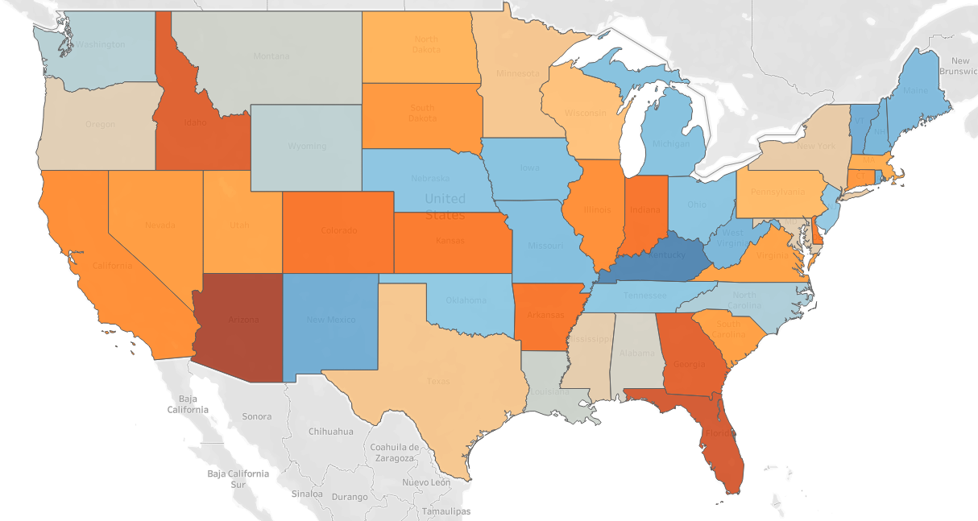
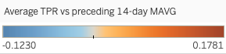
COVID-19: a tale of three states
Populations have responded differently to the COVID-19 pandemic. Spatial analysis in Tableau can help in the analysis of approaches to managing the pandemic.
By analysing test positivity rates (positive tests as fraction of all tests conducted), we can identify various patterns of disease dynamics, and extrapolate future outcomes.
We can then cross-correlate this with changes in mobility characteristics of the underlying population.
Tableau makes it convenient to display and analyse this data dynamically.

Slide 7
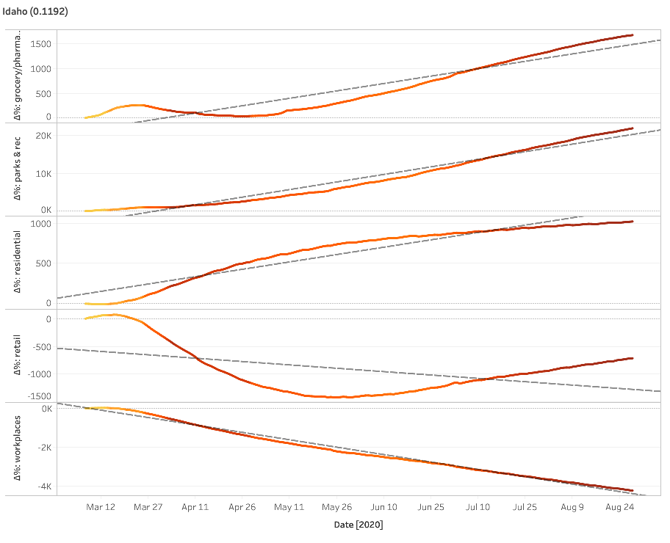
COVID-19: a tale of three states
Some states, such as Idaho (see left), have enacted relatively modest measures of social distancing.
While workplaces remain largely less visited and retail is significantly less than it was in early March, grocery/pharmacy visits and visits to parks and recreational facilities has rebounded.
As a consequence, as the colour of the line indicates, test positivity rates have increased.

